Slide 1
Design and drawing for production
Unit 1 – Introduction & Design Process
Section 2 – Drafting As A Problem-Solving Tool

Slide 2
The big idea
Introduce the course syllabus to know what units and sections are scheduled and what assignments are due.
Introduce classroom operations and procedures for a safe and exciting working environment.

Slide 3
Problem Solving
Process of seeking practical solutions to a problem
Problems can be classified as 2 types:
Well-structured
Only one correct answer with minimal constraints or requirements
Non-structured
Vary in correct solutions, could easily be more then one
Typical solved by creative problem solving

Slide 4
Drafting as a design tool
The design method is used by all engineers and drafters in the industry
Helps a user solve a problem by designing a ‘FINAL SOLUTION’
Space Rovers are a great example as they started out as
rough sketches
Models or prototypes were made and tested on Earth
Later a finished product was then sent to the moon

Slide 5
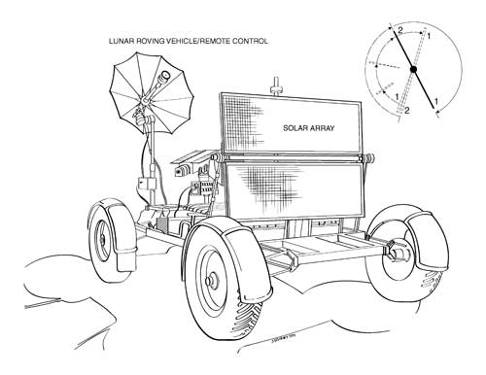

Slide 6
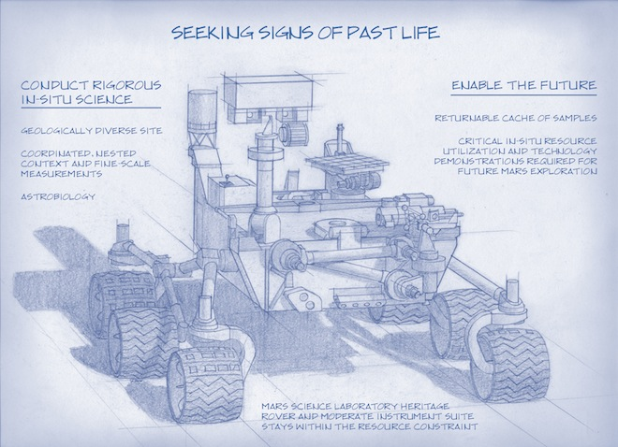

Slide 7
Design method
Very simple 4 step approach
Problem definition
A written statement needs to be clear and understood
Requirements or constraints indicated (desired features)
Any limitations or restrictions outlined
Research into the problematic area
Preliminary Solutions
Preliminary Solution Refinement
Decision and Implementation

Slide 8
In Practice
PROBLEM
Roofers routinely lose standard pencils when working on a customers roof but when placed down, they roll off the roof or into a gutter.
ACTIVITY
Using rough sketches, design AT LEAST 5 different solutions in order to solve the problem.

